Slide 1

Technical & Financial Proposal for Automotive Dealership Marketing and Selling Application
16 June 2022

Slide 2

Who we are
Our Mission
Tekrowe is technology company founded in August 2020, specializing in all life cycles of technology and product development. Our founding team has a combined experience of over 50 years in building high quality, robust and scalable products.
Our mission is to empower innovators to solve problems by allowing them to focus on business development and growth while Tekrowe manages the technology and product side of things.

Slide 3
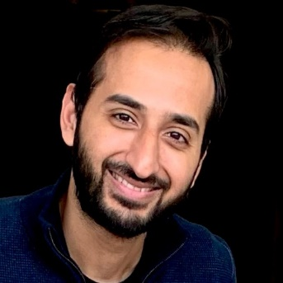




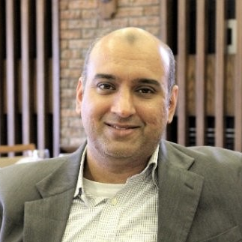






Leadership Team
Zohaib Akmal
Prior to starting Tekrowe Digital, Zohaib was the CTO and Co Founder of a funded Telemedicine Startup Speetar that is currently operating in MENA region. Zohaib has over 10 years of experience working in software and product development for some of the largest companies in the US. Zohaib holds Masters Degree in Computer Science from Dartmouth College USA.
Shoaib Akmal
Shoaib Akmal has over 20 years of experience leading Technical and Strategic projects and organization. Shoaib has spent over 16 years in the US where he developed products and managed large teams for the biggest Telecommunication company in USA. Shoaib holds and MBA from University of Ca. Irvine and Masters Degree in Electrical Engineering from Georgia Tech Atlanta Georgia in the US.
Asim Ajmal
Asim Ajmal has over 22 years of experience of Product Development & Consulting, Programs and Delivery Management, in the areas of large-scale data management, data science, data analytics and engineering solutions in North America, Nordics, EMEA and APAC regions. Asim holds a Masters Degree in Computer Science from Islamic University Islamabad and Certifications in the area of Delivery Excellence

Slide 4
Technical & Financial Proposal

Slide 5
Scope of the Application
Bidding App
Seller App
Super Admin App
SEO optimizied and CMS based web application that will cover end to end bidding process for 7 different auto dealerships
Adaptive landing page with rest of the application that includes configurable widgets.
Connectivity with the pre-developed backend to get listing and details of different vehicles.
Mutilpe buying options like trade, finance and from individual sellers
Web based seller application that based on the technologies defined for Bidding App.
Inventory, users, stores and appointments management
Implementation of complete sales workflow.
Admin Panel to manage and administer the backend application
Should be based on the same technology stacks as Bidding and Seller Apps
Should be able to manage the users, groups, permissions and overall website management.
Following Wireframes will be followed to develop the applications
https://www.figma.com/file/eZ7R9OwuUklZjljEYQk0r9/Vehicle-Bidding-Mine-Updated?node-id=0%3A1
https://www.figma.com/file/A4bylbdLqOihYKbEb1KBwf/Vehicle-Bidding-Seller?node-id=0%3A1

Slide 6
Technology Stack
Development Technologies
ReactJS
NextJS
NodeJS
Strapi CMS
Cloud & Hosting
AWS or Client's Data Center

Slide 7
Tentative Sprints Plan (20 Weeks)
4 Weeks
3 Weeks
1 Weeks
Sprint 2 Tasks as represented on Trello Board
Sprint 4 Tasks as represented on Trello Board
Sprint-1
Sprint-2
Sprint-3
Sprint-4
Sprint-5
Project Setup, Requirement Gathering and Solution Analysis
Sprint 3 Tasks as represented on Trello Board
SIT, Corner Cases, Full Production rollout
4 Weeks
3 Weeks

Slide 8
Tentative Sprints Plan (10 Weeks)
1 Week
1 Week
Product Development using Agile Methodology
Work on Tasks as represented on Scrum Board
Flexible Team size based on requirements
Continued Development and Support as per Requirements
Sprint 1
Sprint 2 … n
MVP Release
Post MVP
Discovery and Requirement Gathering
UI/UX Design finalization
Finalize Project Backlog and Sprint Plan
Create Project Plan and Solution Design
UAT and Full Production Rollout
Release the MVP on Data Migration if needed
2 week Sprints
2 Weeks

Slide 9
Effort & Cost Estimates
Engagement Model | Fixed Fee
Man Days Effort | 200 man days
Duration | 20 weeks
First cut (Landing Page, Vehicle Listing, Vehicle Details) | 4 weeks
Total Cost | US$ 2,000

Slide 10
Thank You

